Slide 1
Designing a supplemental library database
Lucas Guimaraes,
Phung Vuong,
Constance Wohlford

Slide 2
Introduction – Background
The library already has a functional check-out system
While this check-out system is great, unfortunately, there’s been no system established for Misc. items (DVD’s, Magazines, etc)
There’s been a conflict of what to do, and whether they should be included in the regular system.

Slide 3
Introduction – Identifying the Problem
The problem with simply including Misc. items into the existing Database (among others) is the time needed to borrow Misc. items can be a much longer period of time.
We decided to present our own solution – Have a separate database for Misc items
Thus, we decided to take our skills used in the Database class to come up with a solution,

Slide 4
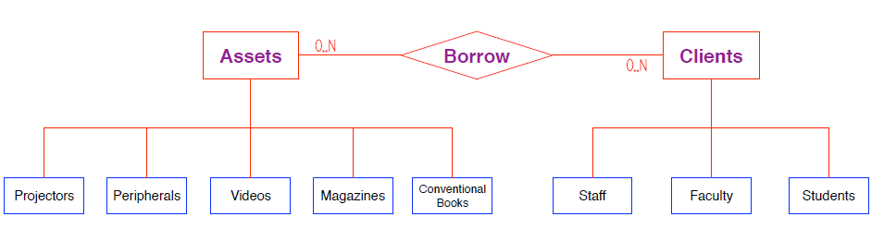
ER Diagram

Slide 5
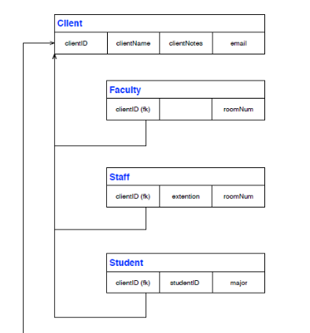
Former Key/Primary Key Diagram

Slide 6
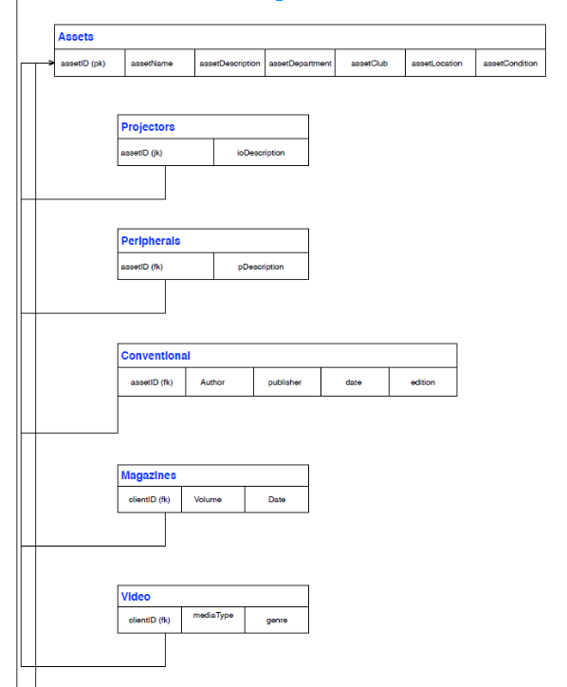

Slide 7
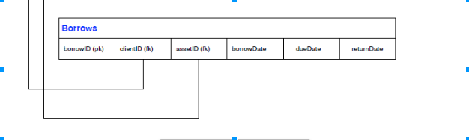

Slide 8
Data Directory
Client clientID | Char of 9 positions
extention | Char of 5 positions
roomNumber | Char of 10 positions
Students clientID | Char of 9 positions
studentID | char of 12 positions
major | Char of 20 positions
Faculty clientID | Char of 9 positions
roomNumber | Char of 30
Assets assetID | Num of 4 positions
assetName | Char of 20 positions
assetDescription | Char of 40 positions
assetDepartment | Char of 20 positions
assetClub | Char of 20 positions
assetLocation | Char of 20 positions
assetCondition | Text variable length
Staff clientID | Char of 9 positions
clientName | Char of 30
clientNotes | Text variable length

Slide 9
Data Dictionary (cont)
Projectors ioDescription | Text variable length
Videos mediaType (DVD, VHS, Reel) | Char of 10 positions
genre | Char of 20 positions
Peripherals pDescriptoin | Text variable length
Players mediaType | Text of variable length
Conventional Author | Char of 30 positions
publisher | Char of 20 positions
date | Date()
edition | Char of 10 position
Borrows borrowID | Num of 4 positions
clientID | Char of 9 positions
assetID | Num of 4 positions
borrowDate | Date()
dueDate | Date()
returnDate | Date()
Magazines Volume | Char of 10 positions
Date | Date()

Slide 10
Create Tables
CREATE TABLE Client (clientID VARCHAR(9) NOT NULL, clientName VARCHAR(30), clientNotes CLOB);
CREATE TABLE Faculty (clientID VARCHAR(9) NOT NULL, roomNumber VARCHAR(10));
CREATE TABLE Staff (clientID VARCHAR(9) NOT NULL, extention vARCHAR(5), roomNumber VARCHAR(10));
CREATE TABLE Student (clientID VARcHAR(9) NOT NULL, studentID VARCHAR(12), major VARCHAR(20));
CREATE TABLE Assets (assetID SMALLINT NOT NULL, assetName VARCHAR(20), assetDescription VARCHAR(40), assetDepartment VARCHAR(20), assetClub VARCHAR(20), assetLocation VARCHAR(20), assetCondition CLOB);
CREATE TABLE Projectors (assetID SMALLINT NOT NULL, ioDescription CLOB);
CREATE TABLE Peripherals (assetID SMALLINT NOT NULL, pDescription CLOB);
CREATE TABLE Conventional (assetID SMALLINT NOT NULL, Author VARCHAR(30), publisher VARCHAR(20), cDate date, edition VARCHAR(10));
CREATE TABLE Magazines (assetID SMALLINT NOT NULL, Volume VARCHAR(10), mDate DATE);
CREATE TABLE Video (assetID SMALLINT NOT NULL, mediaType vARCHAR(10), genre VARCHAR(20));
CREATE TABLE Player (assetID SMALLINT NOT NULL, mediaType CLOB);
CREATE TABLE Borrows (borrowID SMALLINT NOT NULL, clientID VARCHAR(9), assetID SMALLINT, borrowDate DATE, dueDate DATE, returnDate DATE);

Slide 11
INSERT INTO
INSERT INTO Client VALUES ('TLC001', 'Connie Wohlford', NULL);
INSERT INTO Client VALUES ('TLC002', 'Phung Vuong', 'Graduating Spr 2015');
INSERT INTO Client VALUES ('TLC003', 'Lucas Guimaraes', NULL);
INSERT INTO Client VALUES ('TLC004', 'Keyre Figueroa', NULL);
INSERT INTO Client VALUES ('TLC005', 'Diamond Atkins', NULL);
INSERT INTO Client VALUES ('TLC006', 'Misael Salmeron', NULL);
INSERT INTO Client VALUES ('TLC007', 'Mario Guimaraes', NULL);
INSERT INTO Client VALUES ('TLC008', 'Mark Barnum', NULL);
INSERT INTO Client VALUES ('TLC009', 'Anne Reinisch', NULL);

Slide 12
INSERT INTO (sample data)
INSERT INTO Faculty VALUES ('TLC007', '440');
INSERT INTO Faculty VALUES ('TLC008', '435');
INSERT INTO Staff VALUES ('TLC009', '5555', '310');
INSERT INTO Student VALUES ('TLC001', 'WO00', 'CIS');
INSERT INTO Student VALUES ('TLC002', 'VU00', 'CIS');
INSERT INTO Student VALUES ('TLC003', '201400', 'CIS');
INSERT INTO Student VALUES ('TLC004', 'FI00', 'CIS');
INSERT INTO Student VALUES ('TLC005', 'AT00', 'CIS');
INSERT INTO Student VALUES ('TLC006', 'SA00', 'CIS');

Slide 13
INSERT INTO (sample data)
INSERT INTO Assets VALUES (1001, 'Eagle Eye', NULL, NULL, 'IT CROWD', '335', 'like new');
INSERT INTO Assets VALUES (1002, 'Projector 1', 'Portable projector', 'Library', NULL, 'Library', 'good');
INSERT INTO Assets VALUES (1003, 'VGA Cable 1', 'VGA F to F, 15F', 'Library', NULL, 'Library', 'good');
INSERT INTO Assets VALUES (1004, 'DVD VHS Player 1', 'DVD and VHS Player', 'IT SUPPORT', NULL, 'IT SUPPORT', 'dvd works, not sure about VHS');
INSERT INTO Video VALUES (1001, 'DVD', 'Fiction');
INSERT INTO Projectors VALUES (1002, 'VGA M, HDMI');
INSERT INTO Peripherals VALUES (1003, ‘VGA F to F, 15F');
INSERT INTO Player VALUES (1004, 'DVD, VHS');

Slide 14
INSERT INTO (sample data)
INSERT INTO Borrows VALUES (1001, 'TLC001', 1003, TO_DATE('12012014', 'mmddyyyy'), TO_DATE('12032014', 'mmddyyyy'), NULL);
INSERT INTO Borrows VALUES (1002, 'TLC002', 1004, TO_DATE('12012014', 'mmddyyyy'), TO_DATE('12052014', 'mmddyyyy'), TO_DATE('12042014', 'mmddyyyy'));
INSERT INTO Borrows VALUES (1003, 'TLC003', 1001, TO_DATE('12022014', 'mmddyyyy'), TO_DATE('12122014', 'mmddyyyy'), NULL);
INSERT INTO Borrows VALUES (1004, 'TLC004', 1002, TO_DATE('12062014', 'mmddyyyy'), TO_DATE('12092014', 'mmddyyyy'), NULL);
INSERT INTO Borrows VALUES (1005, 'TLC005', 1004, TO_DATE('12072014', 'mmddyyyy'),
TO_DATE('12312014', 'mmddyyyy'), NULL);

Slide 15
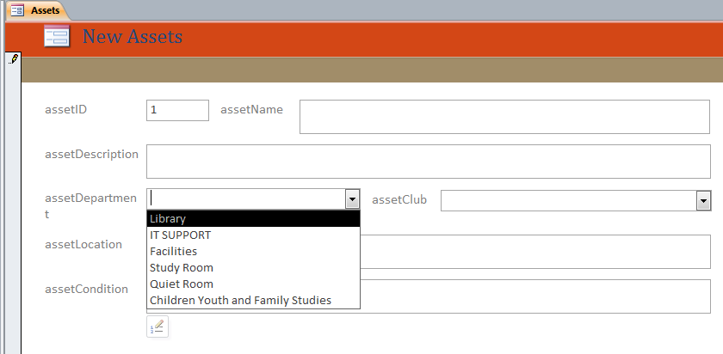
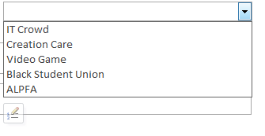

Slide 16
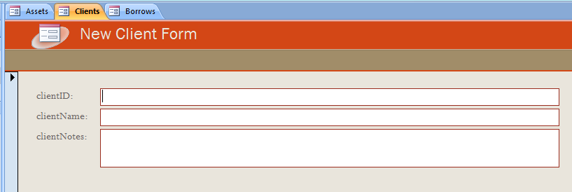

Slide 17
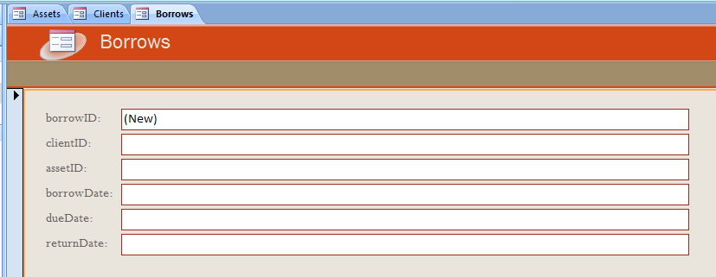

Slide 18
CRUD Matrix
CRUD Matrix (Forms x Tables)
 | Client table | Asset Table | Borrows table
New CLIENT form | CRU
New Asset form |  | CRU
Borrows form | R | R | CRU

Slide 19
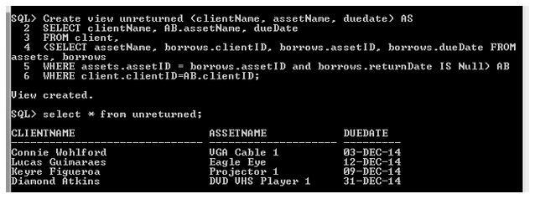
Views
This view shows all assets that are not returned.
Create view unreturned (clientName, assetName, duedate) AS
SELECT clientName, AB.assetName, dueDate
FROM client,
(SELECT assetName, borrows.clientID, borrows.assetID, borrows.dueDate FROM assets, borrows
WHERE assets.assetID = borrows.assetID and borrows.returnDate IS Null) AB
WHERE client.clientID=AB.clientID;

Slide 20
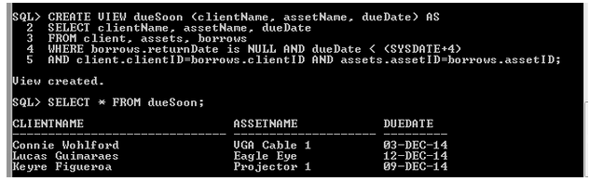
Views
This view shows all assets that are due within four days.
CREATE VIEW dueSoon (clientName, assetName, dueDate) AS
SELECT clientName, assetName, dueDate
FROM client, assets, borrows
WHERE borrows.returnDate is NULL AND dueDate < (SYSDATE+4)
AND client.clientID=borrows.clientID AND assets.assetID=borrows.assetID;

Slide 21
Function
This function returns the number items already borrowed for a given assetID.
DROP FUNCTION AlreadyCheckedOut;
CREATE FUNCTION AlreadyCheckedOut(assetIDtoCheck IN SMALLINT)
RETURN number
IS
borrowed number:=0;
BEGIN
SELECT count(borrowID) INTO borrowed FROM borrows WHERE assetIDtoCheck = assetID and returnDate is NULL;
Return borrowed;
END;
/

Slide 22
Difficulties Encountered
Multi valued data
  Appropriate verses Inappropriate for our case
How many attributes to include
Describing Databases is just as difficult as designing them (software to create diagrams, pdfs, documents)

Slide 23
Results, Conclusions, next steps
A supplemental database is ideal for tracking these kinds of items.
Ideally, this would be tested with real data and utilized by campus for a few months.

Slide 24
Questions

