Slide 1
Small College Recruitment and Marketing:
How can TLC.edu be improved to better recruit students?
Constance Wohlford
Senior Research Capstone
Trinity Lutheran College
Fall 2014

Slide 2
Summary
My project
  Introduction and background
  Literature review
  Methods
  Results
Next steps
Capstone Portfolio

Slide 3
Abstract
Research College Admissions Websites against ideal college websites as defined by Wohlford (2013) and Poock and Lafond (2001).
Quantitative and qualitative methods were used.

Slide 4
Introduction & Background
Coming to this college should be the easiest part!
The Communications Department
Insights from peer institution websites
Framework
Information I have access too
Top viewed sites were compared to least viewed sites.
The system was validated during Research Methods
Notes:
The Communications Department asked me last year to review peer institution websites in order to gain insights about improvements that can be made on our own webpage. This was commissioned to increase admissions and recruitment.
I had no framework for which to make these suggestions
But I did have access to data about our own site
Top viewed sites were compared to least viewed sites in an effort to determine what non-campus viewers value in our webpage. Indeed, as expected, the scoring system showed better scores for more viewed pages, thus better pages.

Slide 5
Introduction & Background
2001 – Poock & Lafond, 55 UNC Chapel Hill & Michigan students were studied.
Students wanted:
meaningful information
less clicks
≈ 70% text, 30% graphics
2013 – Noel-Levits, 43% of students use mobile for all web browsing.

Slide 6
Literature Review
Pook, M. C., & Lefond, D. (2001). How college-bound prospects perceive university Web sites: findings, implications, and turning browser into applicants. C&U Journal, 77(1), 7.
  “Web sites are critical for colleges and universities for three distinct reasons: communication, access to tools (i.e., databases, indices, directories, etc.), and—perhaps most importantly—promotion and marketing of the institution.”
  “Participants were generally unaware of other constituencies of a university (alumni, faculty, donors, etc.), and therefore viewed any information not directly specific to them as superfluous.”
  “Participants felt strongly that pictures should help the prospective student answer the question, “Will I fit in?””

Slide 7
Methods
Each page is measured on the following variables:
  Number of clicks it took to get there from the index page.
  Scale % of the page that is text verses the percent that is image.
  Category
    General Admissions
    First Year Admissions
  Likert scale of “Will I fit in?”
  Was there an opportunity for dialogic loop?

Slide 8
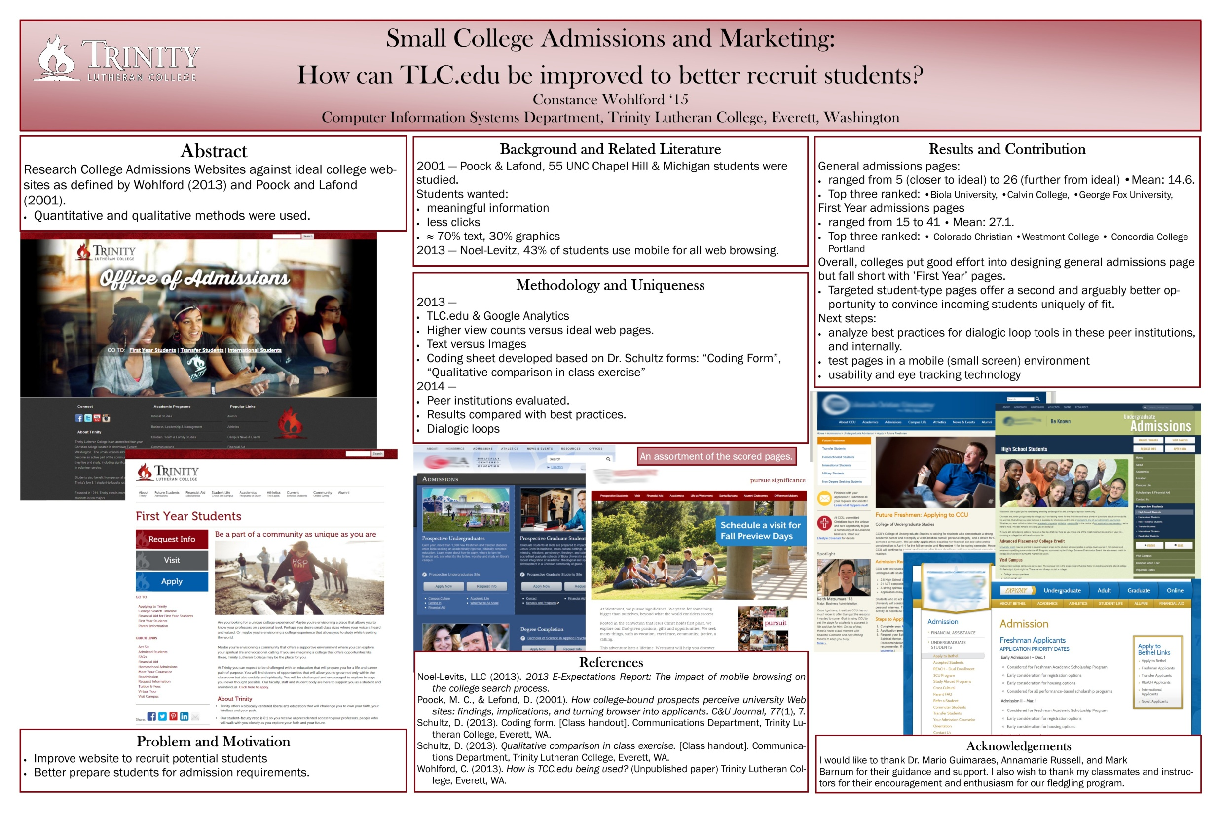

Slide 9
Results
Coding Sheet Number | College | URL |  | Title | Category | Total Score | Order | Average
03 | Biola University | http://www.biola.edu/admissions/ |  |  | Admissions | 5 | A1
09 | Calvin College | http://www.calvin.edu/admissions/ |  |  | Admissions | 6 | A2
14 | George Fox University | http://www.georgefox.edu/admission/index.html |  |  | Admissions | 11 | A3
16 | Seattle Pacific University | http://www.spu.edu/depts/ugadm/ |  |  | Admissions | 15 | A4
05 | Wheaton College | http://wheaton.edu/Admissions-and-aid |  |  | Admissions | 16 | A5
11 | Nyack College | http://nyack.edu/content/FCSExplore |  |  | Admissions | 16 | A5
01 | Concordia College Portland | http://www.cu-portland.edu/admission |  | Admission | Concordia University | Admissions | 17 | A6
07 | Bethel College | http://www.bethelcollege.edu/admission/undergrad |  |  | Admissions | 17 | A6
12 | Colorado Christian | http://www.ccu.edu/admissions/undergrad/ |  |  | Admissions | 17 | A7
18 | Westmont College | http://westmont.edu/admissions/ |  |  | Admissions | 26 | A8 | 14.6
13 | Colorado Christian | http://www.ccu.edu/admissions/freshmen/ |  |  | First Year | 15 | F1
19 | Westmont College | http://westmont.edu/admissions/apply.html |  |  | First Year | 17 | F2
02 | Concordia College Portland | http://www.cu-portland.edu/admission/admission-requirements/freshmen |  | Freshmen | Concordia University | First Year | 18 | F3
15 | George Fox University | http://www.georgefox.edu/college-admissions/student/high-school.html |  |  | First Year | 23 | F4
04 | Biola University | http://undergrad.biola.edu/apply/process/first-time/ |  |  | First Year | 30 | F5
06 | Wheaton College | http://wheaton.edu/Admissions-and-aid/Undergrad/prospective-students/Freshman-Applicants |  |  | First Year | 34 | F6
10 | Calvin College | http://www.calvin.edu/admissions/apply/first-year/ |  |  | First Year | 39 | F7
08 | Bethel College | http://www.bethelcollege.edu/admission/undergrad/apply/first-freshman.html |  |  | First Year | 41 | F8
17 | Seattle Pacific University |  |  |  | First Year | - |  | 27.125

Slide 10
Conclusions
This was presented at CCSC 2014 at Gonzaga University in Spokane, Washington
When the top pages are compared against the bottom pages, trends begin to emerge.
Potential students can learn a lot about the environment at a school though the website
  this can be advantageous or work against a school.

Slide 11
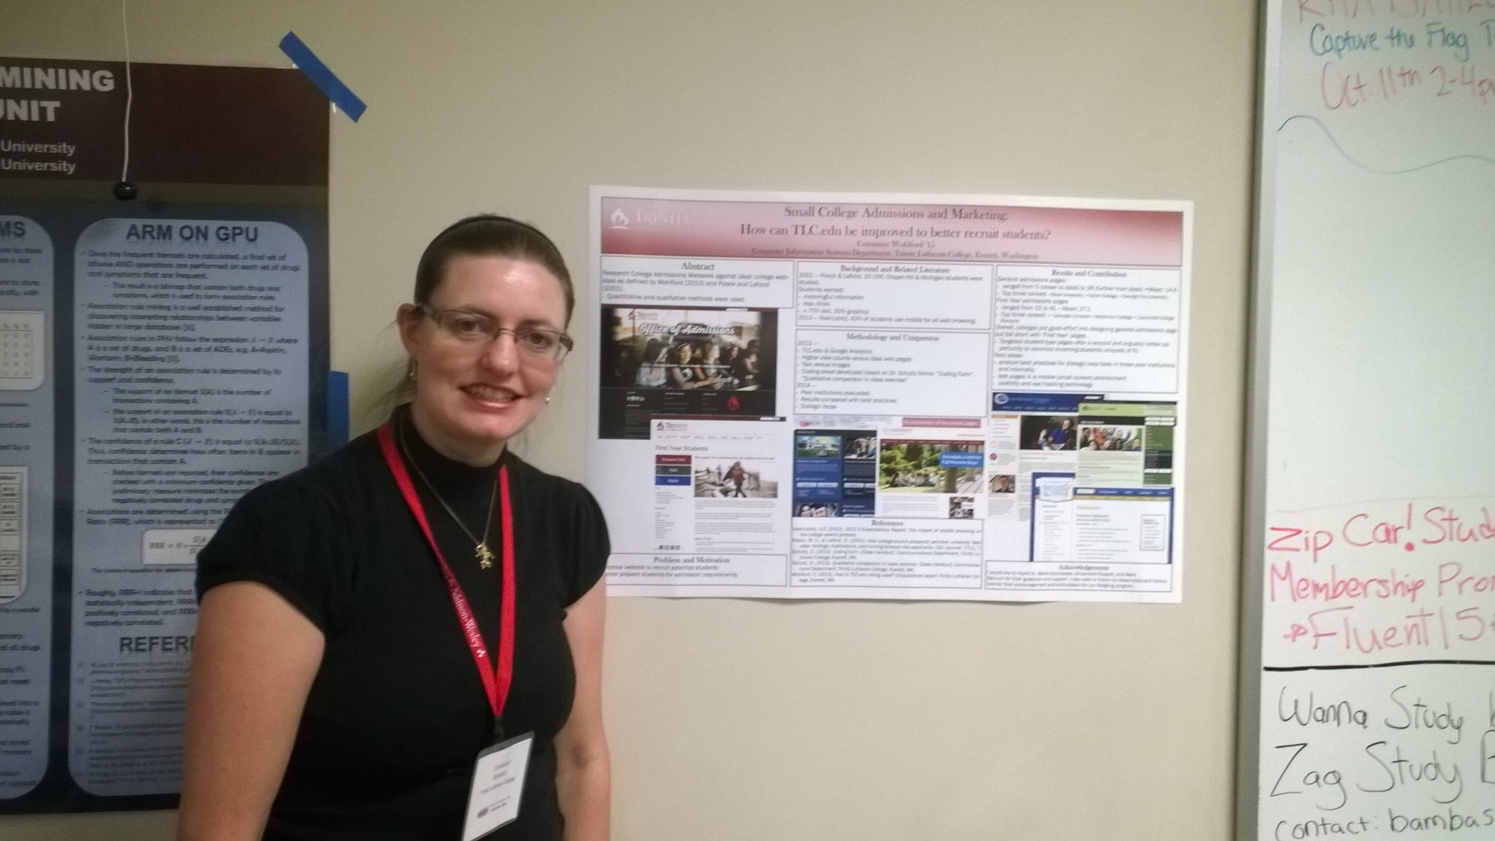

Slide 12
Where should this research go next?
Dialogic loops in college admission processes
Test pages in a mobile (small screen) environment

Slide 13
Portfolio

Slide 14
Questions

